Slide 1
Sensor Fusion Toolbox for Rocket Motion
Luke Aagaard, Kian Jamal, Nathan Tardy, 4/11/2024

Slide 2
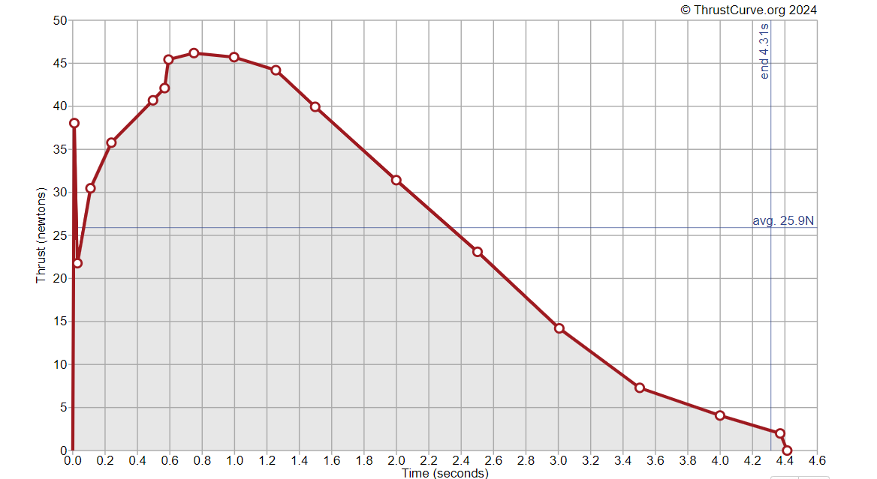
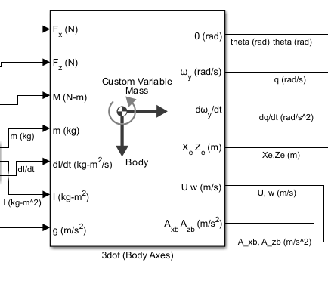
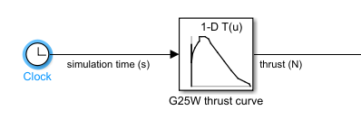
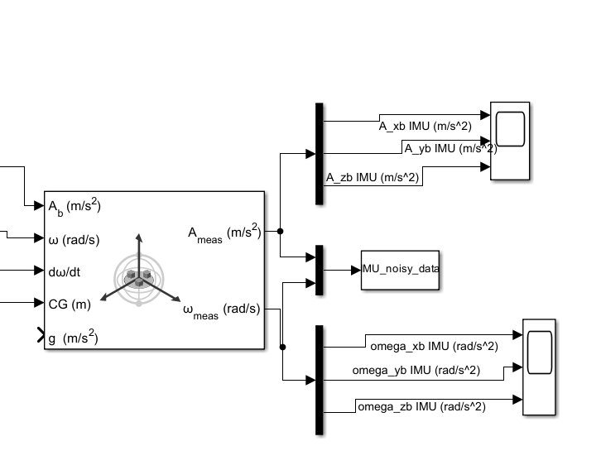
Data Generation
Simulink model
1-D lookup table outputs Aerotech G25W Thrust curve using simulation time (thrust curve data taken from thrustcurve.org).
Three-axis Inertial Measurement Unit data simulation outputs simulated noisy accelerometer and gyroscope data
3DOF block applies the equations of motion (EOM)
1-D lookup table.
3DOF EOM block.
Three-axis IMU simulation block.
04/10/2024
Luke Aagaard
2

Slide 3
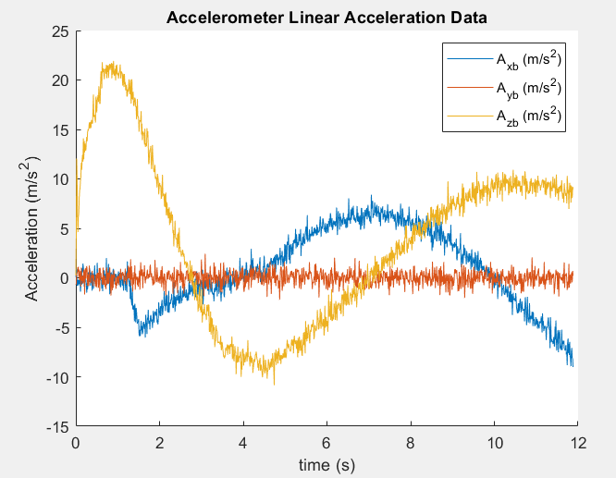
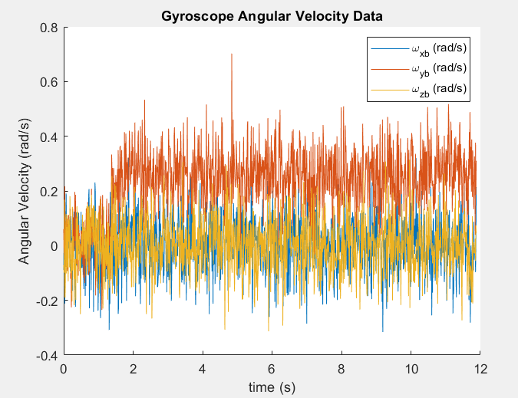
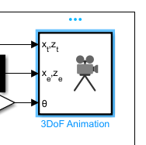
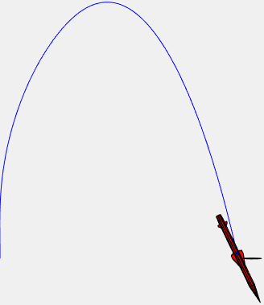
Data Generation
Simulink model
MATLAB
% Luke Aagaard
% AEE 3150 Team Project
% March 28, 2024
clc; clear; close all; format compact;
Simulation_Time = 13; %s
sim('RocketLander_version3.mdl',Simulation_Time)
AccelerationData = load('IMU_noisy_data.mat')
AccelerationData = struct2array(AccelerationData)
AccelerationData = AccelerationData';
3DoF animation block graphic
04/10/2024
Luke Aagaard
3

Slide 4
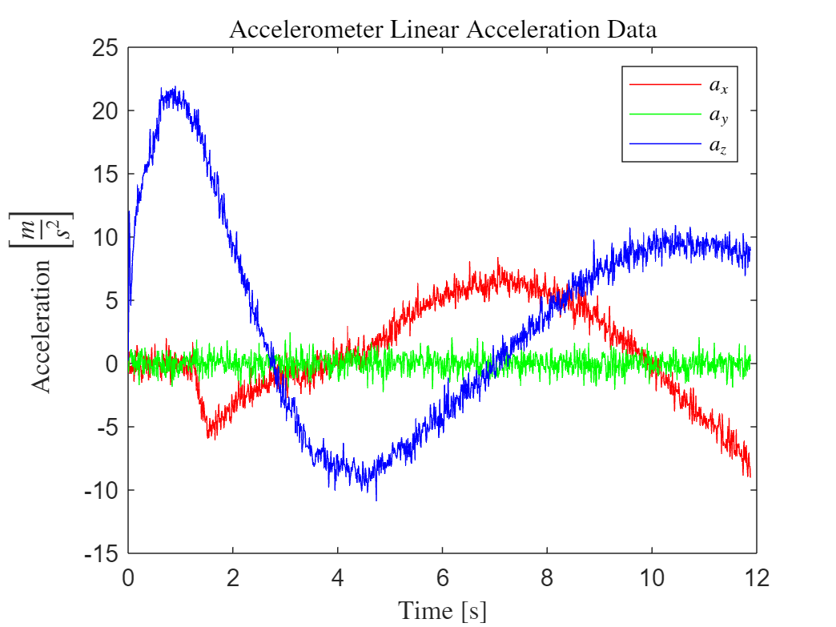
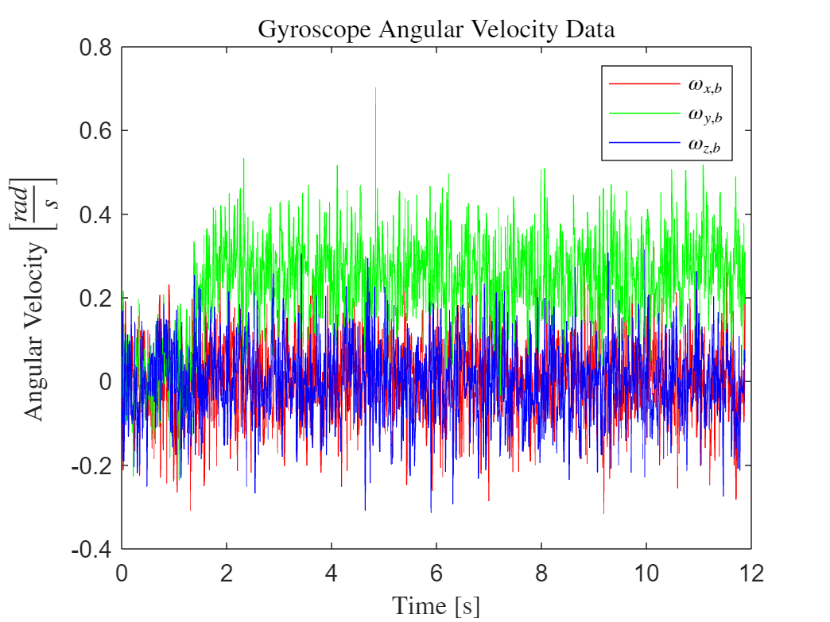
Data Processing
Angular velocity along body axes
Input: raw (noisy) data from virtual sensors
Only really 1 non-zero component due to nature of the motion
No yaw
No roll
Linear acceleration along body axes
4/9/2024
Nathan Tardy
4

Slide 5
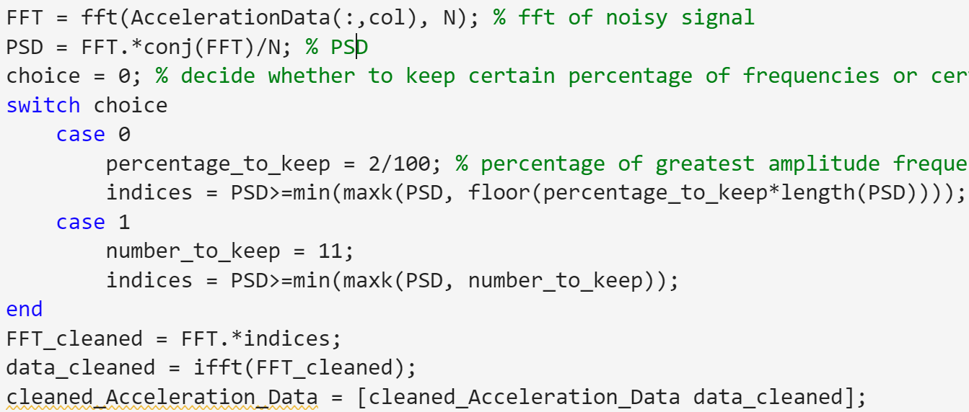
Data Processing
Method: FFT on noisy data (HW 4)
4/9/2024
Nathan Tardy
5

Slide 6
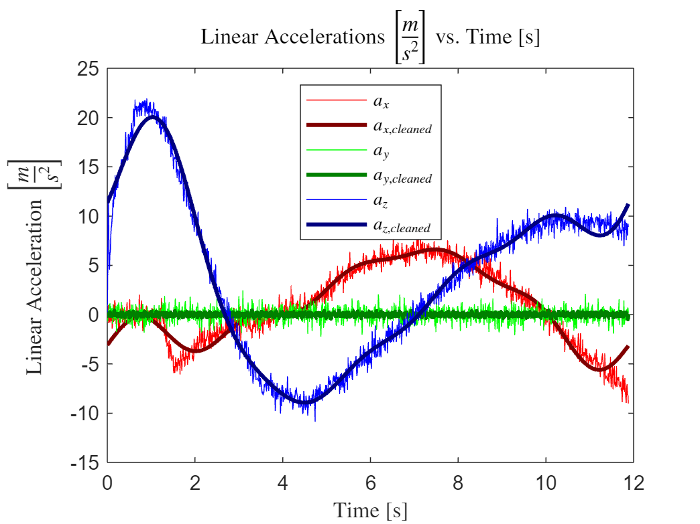
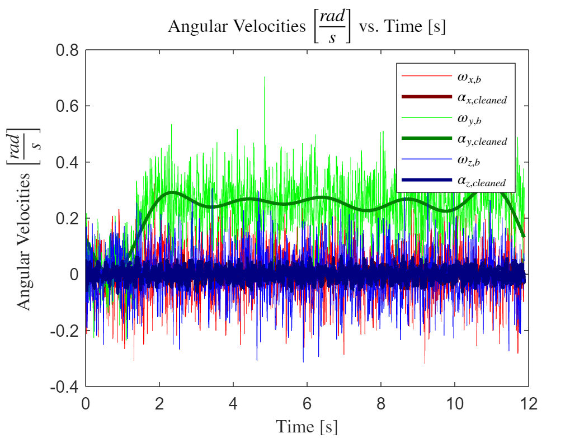
Data Processing
Thin lines: noisy signal
Thick lines: cleaned signal (n = 11)
4/9/2024
Nathan Tardy
6

